Slide 1

Physics Informed Deep Operator Networks
Bachelor’s Thesis Project -I and II
Prathvik G S 20PH20028
Under the Guidance of
Dr Venkatesh Gopinath - Bosch Research
Prof Shivakiran Bhaktha - IIT Kharagpur
Department of Physics, Indian Institute of Technology, Kharagpur

Slide 2
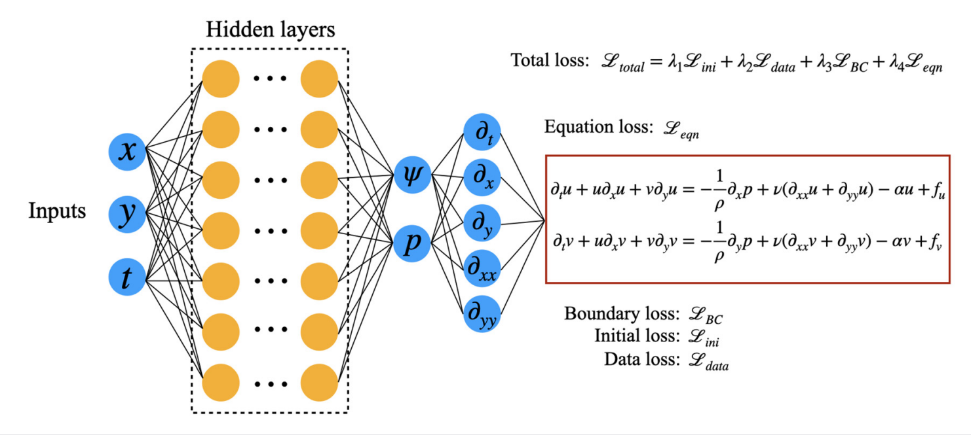
How does a PINN work
Source: https://pubs.aip.org/aip/pof/article/34/5/055130/2847510/Physics-informed-data-based-neural-networks-for

Slide 3
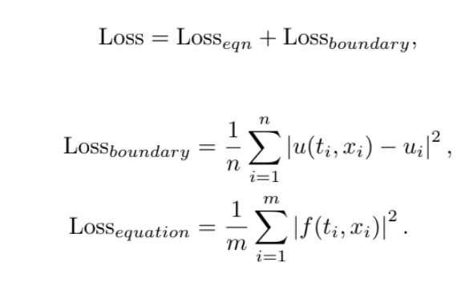
Mean Squared Loss Function

Slide 4
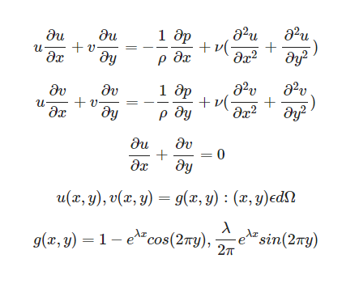
Example- solving a system of equations

Slide 5
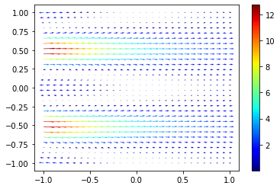
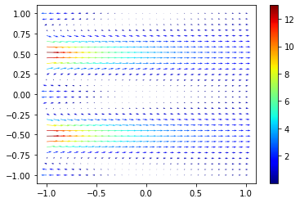
PINN Solution
Analytical solution

Slide 6
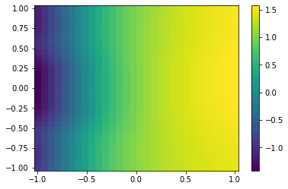
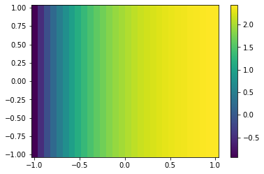
We can obtain the pressure upto a constant without even using any information about the pressure
Pressure Field obtained from PINN
Analytical Pressure

Slide 7
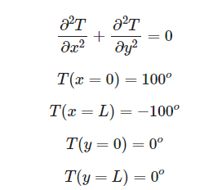
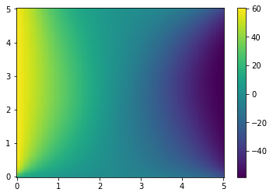
Heat equation solution on a square plate using PINN

Slide 8
def loss(xy,xyb1,xyb2,xyb3,xyb4):
with tf.GradientTape(persistent=True) as tape:
x,y=tf.unstack(xy,axis=1)
tape.watch(x)
tape.watch(y)
T=modelheat(tf.stack((x,y),axis=1))
dTdx=tape.gradient(T,x)
dTdy=tape.gradient(T,y)
d2Tdx2=tape.gradient(dTdx,x)
d2Tdy2=tape.gradient(dTdy,y)
xb1,yb1=tf.unstack(xyb1,axis=1)
Tb1 = modelheat(tf.stack((xb1,yb1),axis=1))
xb2,yb2=tf.unstack(xyb2,axis=1)
Tb2 = modelheat(tf.stack((xb2,yb2),axis=1))
xb3,yb3=tf.unstack(xyb3,axis=1)
Tb3 = modelheat(tf.stack((xb3,yb3),axis=1))
xb4,yb4=tf.unstack(xyb4,axis=1)
Tb4 = modelheat(tf.stack((xb4,yb4),axis=1))
loss = tf.reduce_mean(tf.square(d2Tdx2+d2Tdy2))+tf.reduce_mean(tf.square(Tb1-100))+\
tf.reduce_mean(tf.square(Tb2+100))+tf.reduce_mean(tf.square(Tb3))+tf.reduce_mean(tf.square(Tb4))
return loss
#Define the neural network architecture- takes 2 inputs, the x ,y and gives Temparature
modelheat = tf.keras.Sequential([
tf.keras.layers.Dense(20, activation='tanh', input_shape=(2,)),
tf.keras.layers.Dense(20, activation='tanh'),
tf.keras.layers.Dense(20, activation='tanh'),
tf.keras.layers.Dense(20, activation='tanh'),
tf.keras.layers.Dense(1)
])

Slide 9
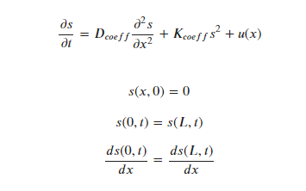
Training info: Physics informed DeepONet for Diffusion Reaction system
No of functions u(x) used for training = 50
No of grid points used for obtaining sol = 2500
No of epochs ~ 500
Loss function = equation_loss+ Initial_Loss
Any Numerical Data use - No
u(x) form -
Where A and B are random coefficients
Equations =>

Slide 10
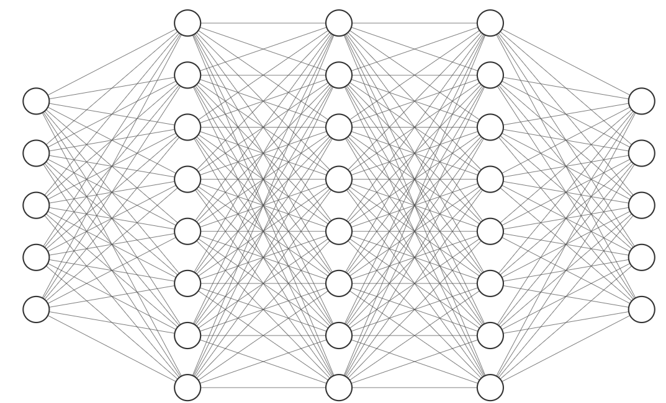
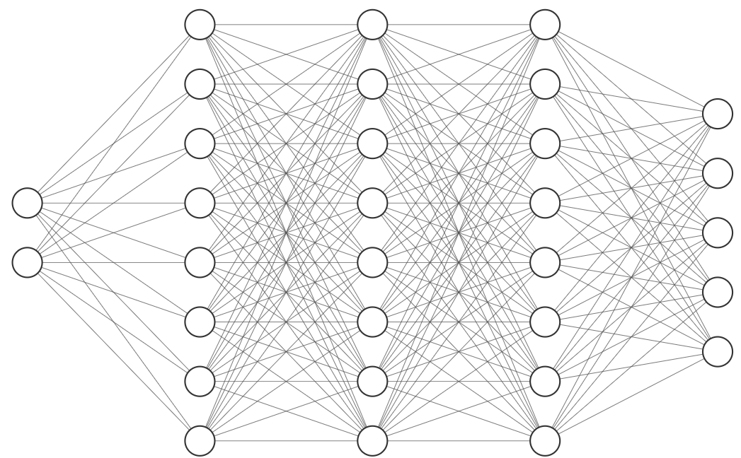
Model architecture
b1
b2
b3
.
.
bn
u(x1)
u(x2)
u(x3)
.
.
.
u(xn)
Branch net
output= ∑ti.bi + (bias)
t1
t2
t3
.
.
tn
xj
tj
Trunck net

Slide 11
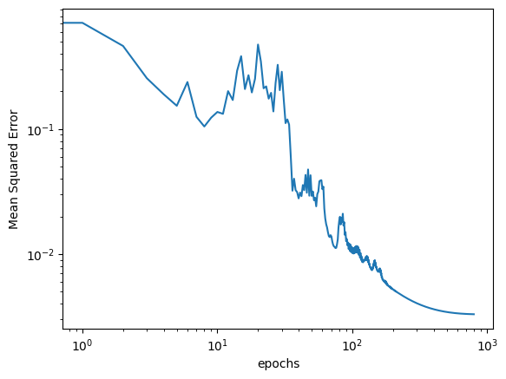
Training Loss vs Epochs

Slide 12
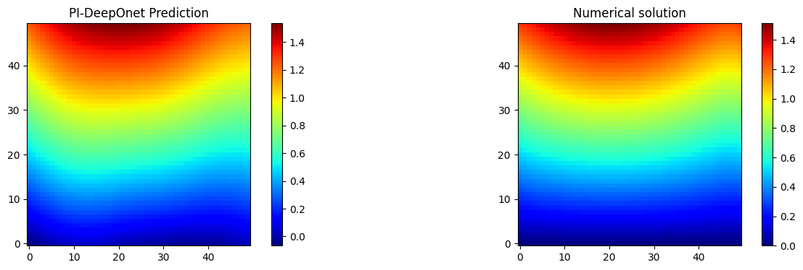
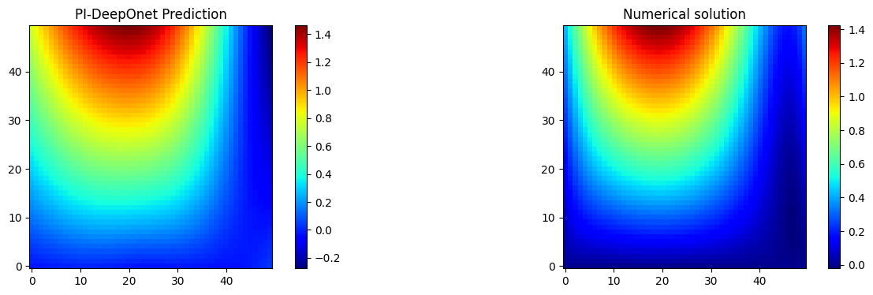
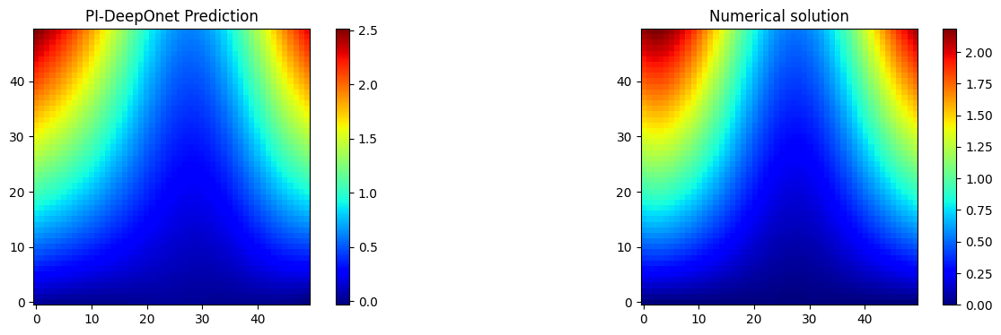
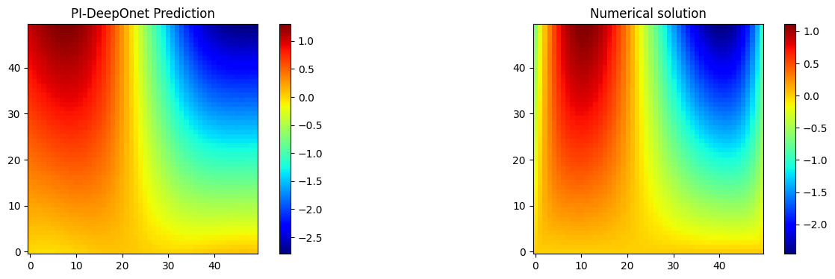
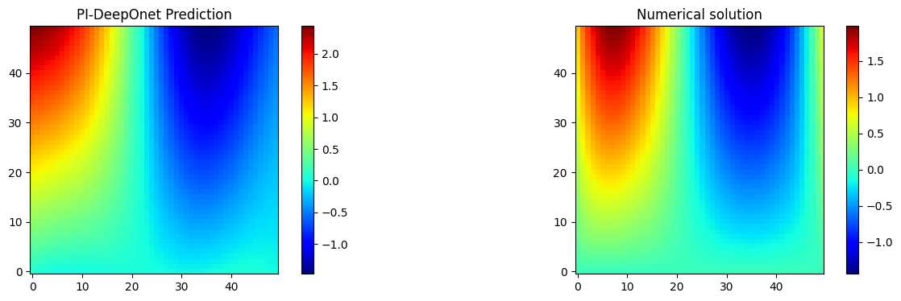
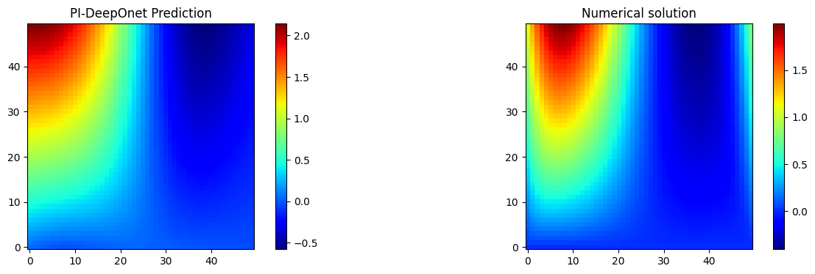
PI-DeepOnet solution for different New Unseen functions along with numerical solution.
The solutions are of different types and the PI-DeepOnet approximates it welly.

Slide 13
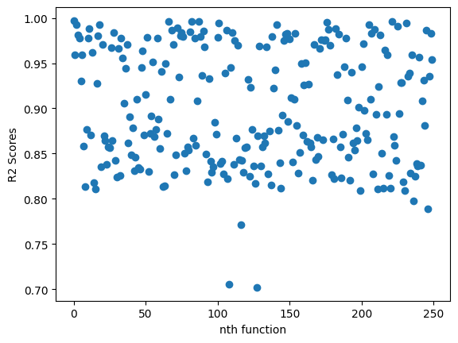
R2 Scores - 250 New Functions , Avg R2 = 0.9 for ~500 epochs

Slide 14
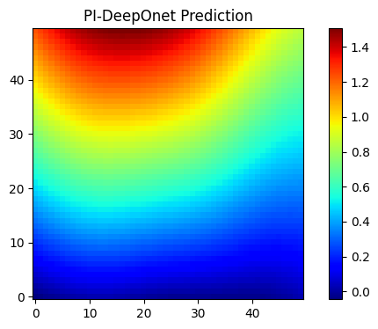
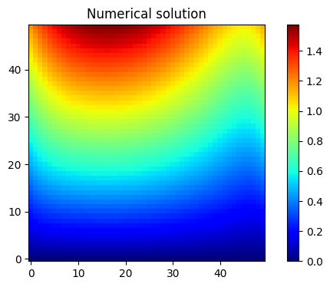
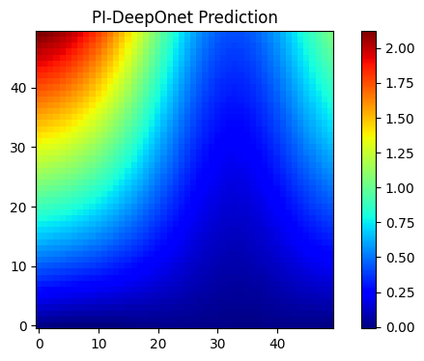
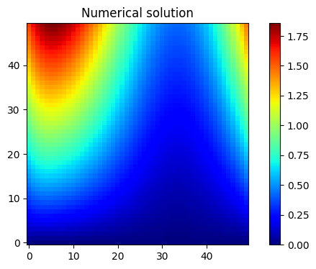
DeepOnet solution for New unseen type of function- Quadratic equation with random coefficients

Slide 15
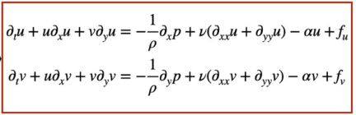
Deep Operator networks for Fluids
In terms of stream function,the governing equation is
Constants -alpha=0.05, nu=0.001, rho=1
Boundary conditions - doubly periodic
Incompressible

Slide 16
Model architecture
b1
b2
b3
.
.
bn
u(x1)
u(x2)
u(x3)
.
.
.
u(xn)
Branch net
output= ∑ti.bi + (bias)
t1
t2
t3
.
.
tn
xj
tj
Trunck net

Slide 17
Architecture for 2 output DeepOnet
b1
b2
b3
.
.
bn
u(x1)
u(x2)
u(x3)
.
.
.
u(xn)
Branch net
output2= ∑ti.bi + (bias)
output1= ∑ti.bi + (bias)
t1
t2
t3
.
.
tn
xj
tj
Trunck net

Slide 18
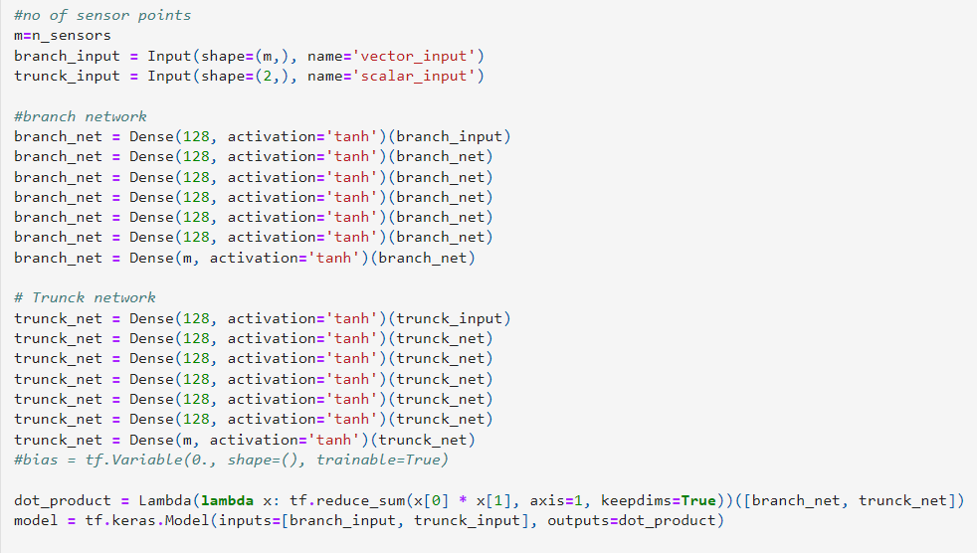

Slide 19
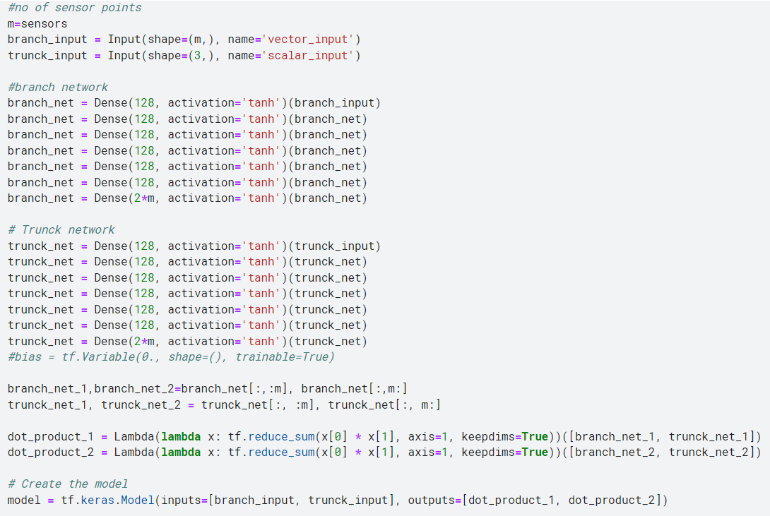
Architecture for 2 output DeepOnet

Slide 20
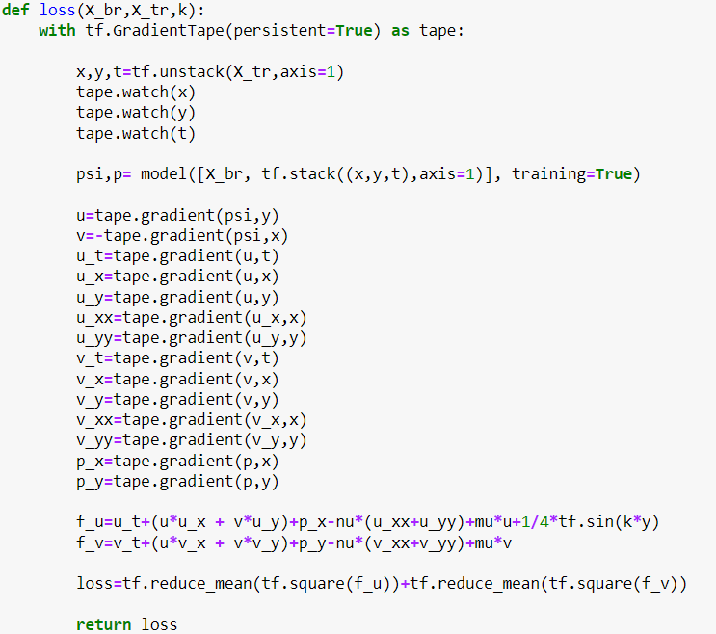
The Custom Loss function for the equations

Slide 21
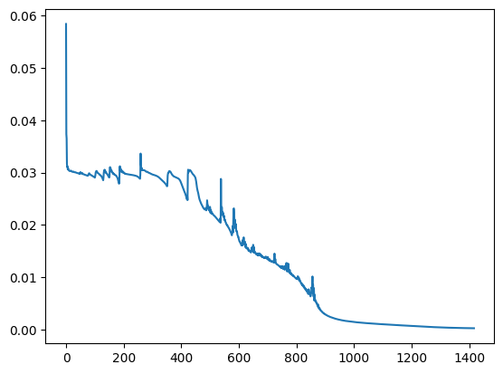
Mean squared error vs epochs

Slide 22
*Let Cost of one PINN simulation for a single f be ‘ S ‘. Then if we want simulations for 500 different functions with different forcing functions, solving using PINNs =[500*S]
*Now Using DeepOnet (Using 100 functions for training let’s say)
Cost to train using 100 functions ~ 100*S
*Using this we can Obtain the solution for as many functions as we want with any random coefficients

Slide 23
Thank you!

